Slide 1
Soft Computing Method And Applications Final Project
presenter :蔡季剛

Slide 2
Outline
Paper
Natural observation
Algorithm
Advantages
Results in the paper
Experiment

Slide 3
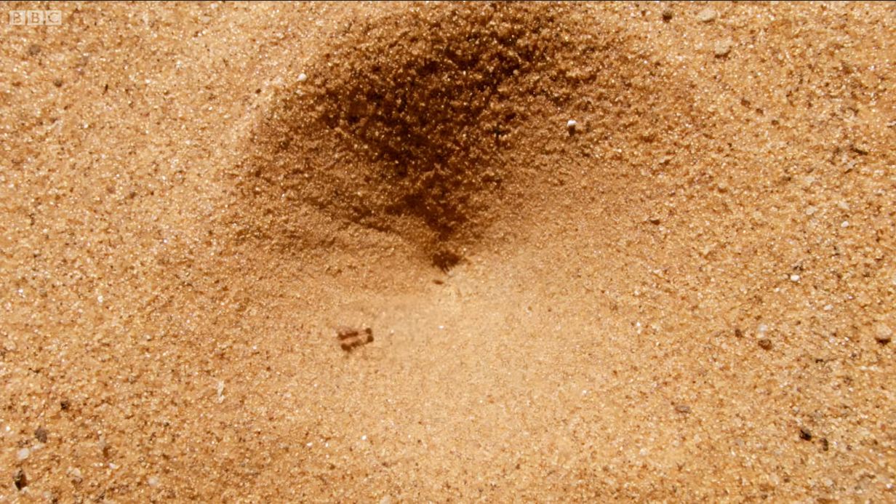
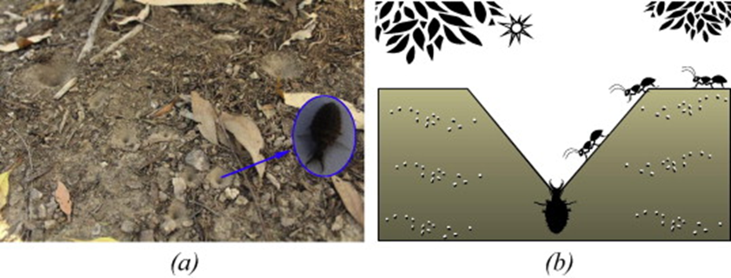


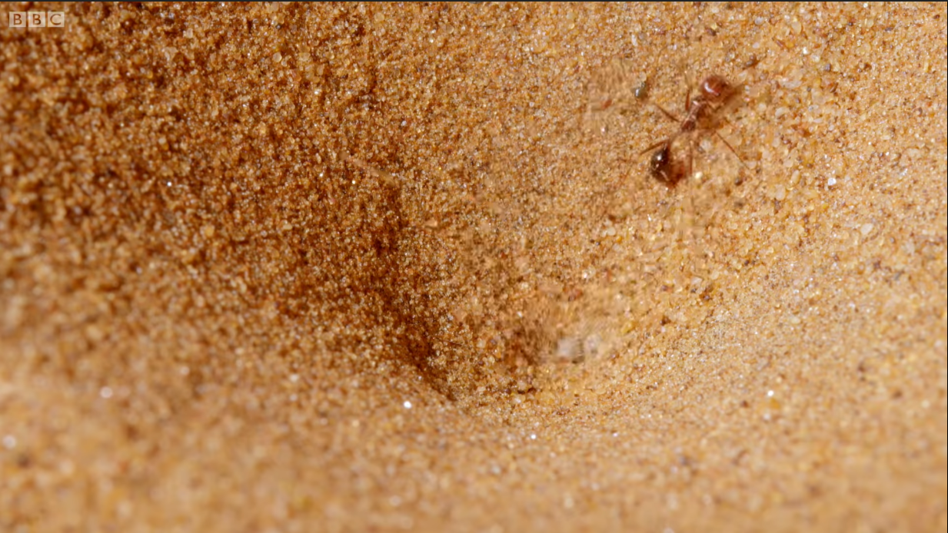
Natural observation

Slide 4
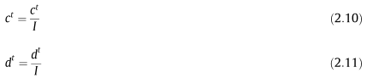
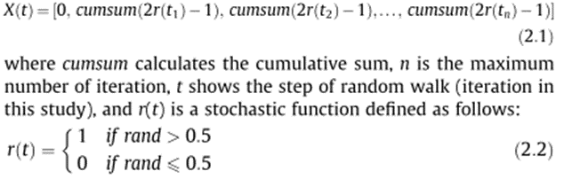
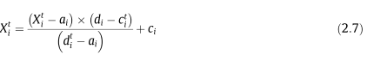
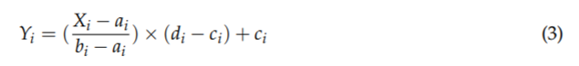
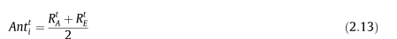
Algorithm
Initialize the first population of ants and antlions randomly
Calculate the fitness of ants and antlions
Find the best antlions and assume it as the elite (determined optimum)
While the end criterion is not satisfied
for every ant
Select an antlion using Roulette wheel
Update c and d using equations Eqs.(2.10), (2.11)
Create a random walk and normalize
Update the position of ant using(2.13)
end for
Calculate the fitness of all ants
Replace an antlion with its corresponding ant it if becomes fitter (Eq. (2.12))
Update elite if an antlion becomes fitter than the elite
end while
Return elite

Slide 5
Algorithm-brief vision
2.2.1. Random walks of ants
2.2.2. Trapping in antlion’s pits
2.2.3. Building trap
2.2.4. Sliding ants towards antlion
2.2.5. Catching prey and re-building the pit
2.2.6. Elitism

Slide 6
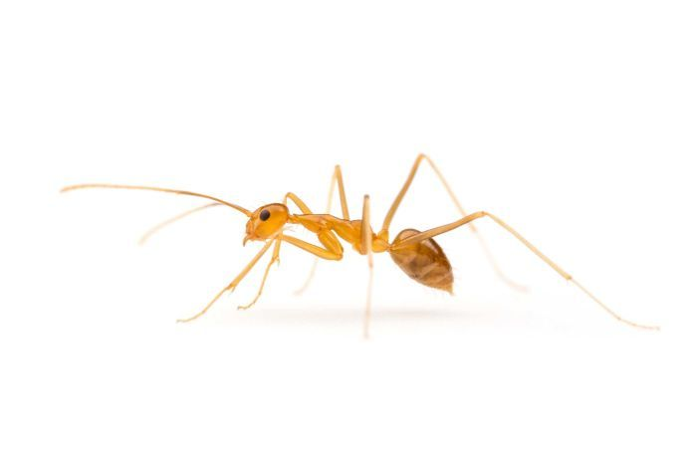
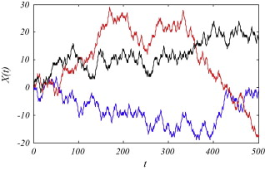
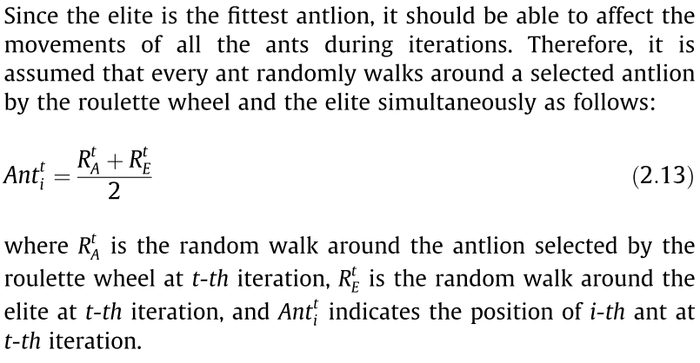
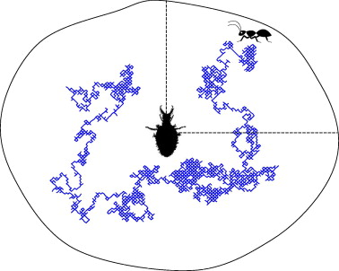
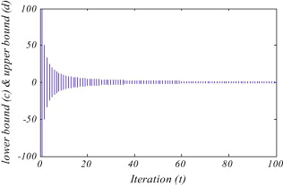
Algorithm-brief vision
Antlions can build pits proportional to their fitness (the higher fitness, the larger pit).
Antlions with larger pits have the higher probability to catch ants

Slide 7
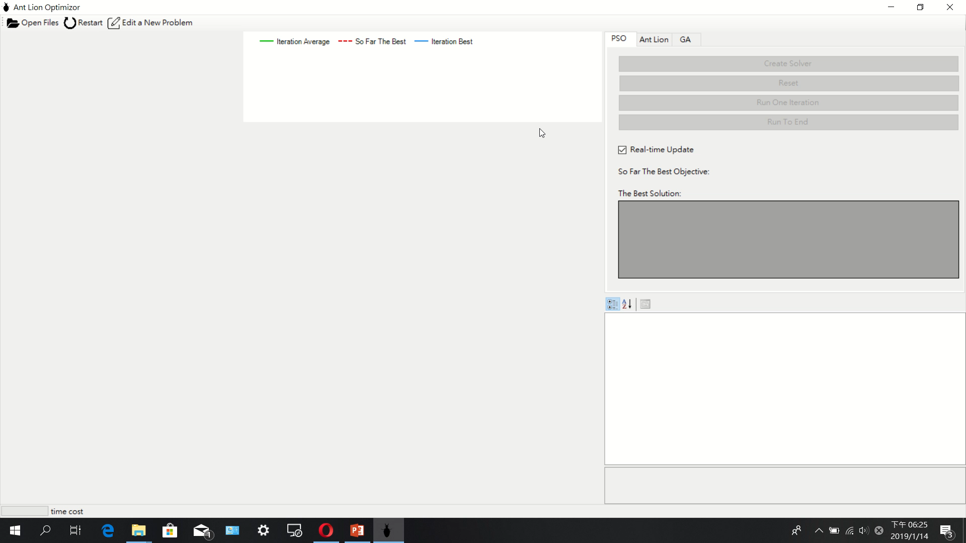

Slide 8
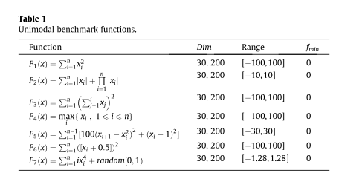
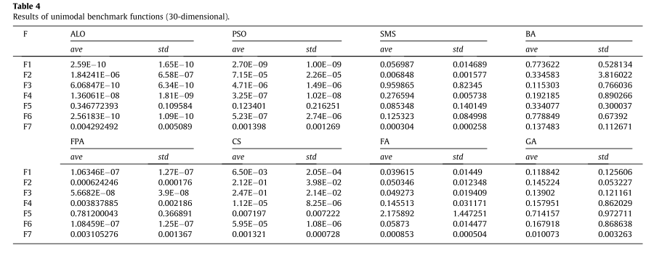
Results in the paper

Slide 9
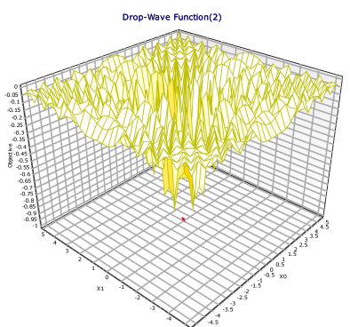
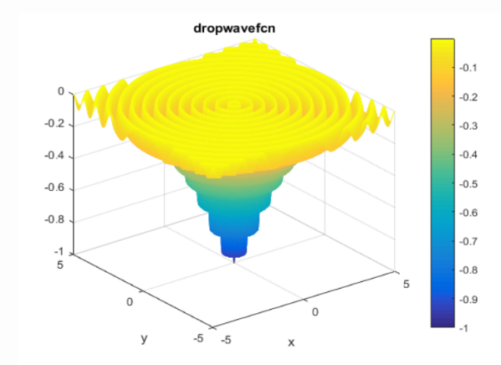
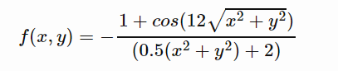
Experiment
 |  | PSO | ALO | ALO' | GA
Ackley(2) | average | 0.05730 | 1.044474751 | 4.63230018 | 0.260433509
 | best | 1.38054E-11 | 0.003569002 | 2.57992846 | 0.040490623
 |  | PSO | ALO | ALO' | GA
Peaks(2) | average | -3.31152E-05 | 0.979521048 | 2.09410 | 0.702161352
 | best | -3.33328E-05 | -1.73469E-05 | 9.0326E-05 | -3.33328E-05
 |  | PSO | ALO | ALO' | GA
Drop-Wave (2) | average | 0.000565286 | 0.153988876 | 0.09674442 | 0.063634672
 | best | 8.50287E-08 | 0.063755097 | 0.06375697 | 0.063154672
 |  | PSO | ALO | ALO' | GA
Holder-Table (2) | average | 1.67208718 | 0.150847233 | 0.84181756 | 0.001175808
 | best | 0.013556701 | 0.000616318 | 0.00057716 | -2.56789E-06
 |  | PSO | ALO | ALO' | GA
Powell Sum(3) | average | 0.004984868 | 0.000888069 | 0.04185838 | 8.64481E-06
 | best | 0.002513004 | 0.000164943 | 1.7711E-05 | 5.88202E-09
 |  | PSO | ALO | ALO' | GA
Powell Sum(30) | average | 0.010796917 | 0.494948873 | 0.79417227 | 0.019452172
 | best | 0.003705383 | 0.022914694 | 0.0138044 | 0.003705383
 |  | PSO | ALO | ALO' | GA
Styblinski-Tank(30) | average | 535.8239949 | 557.3091382 | 678.885113 | 93.34687886
 | best | 464.6442315 | 243.0194402 | 513.600057 | 77.27144089
 |  | PSO | ALO | ALO' | GA
Sum Squares(30) | average | 835.44809 | 426.5497813 | 182.493506 | 144.3985231
 | best | 534.8195822 | 66.79109414 | 117.017712 | 124.387319

Slide 10
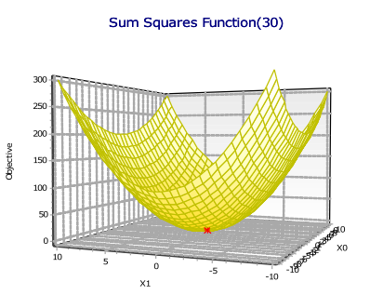
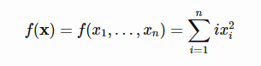
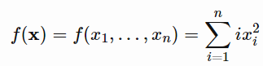
 | Sum Squares(30) |  | Sum Squares(30)
ALO1 | 46.28360156 | GA1 | 111.4095798
ALO2 | 171.0654764 | GA2 | 132.6117137
ALO3 | 76.48067463 | GA3 | 234.7123592
ALO4 | 94.799438 | GA4 | 140.2118797
ALO5 | 9115.026402 | GA5 | 133.4952407
ALO6 | 88.31186917 | GA6 | 98.90437844
ALO7 | 83.25047089 | GA7 | 265.549655
ALO8 | 48.81373694 | GA8 | 275.575024
ALO9 | 40.30468079 | GA9 | 220.6851996
ALO10 | 33.03857446 | GA10 | 100.3219545
ALO11 | 92.49679619 | GA11 | 138.2326614
ALO12 | 54.25030303 | GA12 | 150.3469579
ALO13 | 71.10581087 | GA13 | 133.3024248
ALO14 | 9038.117474 | GA14 | 124.2771063
ALO15 | 110.1956957 | GA15 | 137.6209533
ALO16 | 129.2934443 | GA16 | 112.380226
ALO17 | 8969.121064 | GA17 | 103.3421586
ALO18 | 97.80467007 | GA18 | 206.5501971
ALO19 | 54.96814368 | GA19 | 152.5644714
ALO20 | 114.0439195 | GA20 | 83.83248688

Slide 11
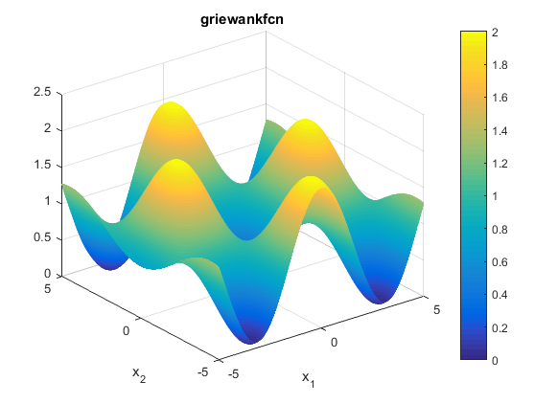
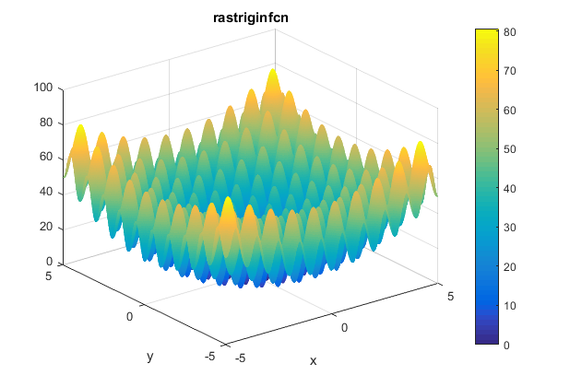
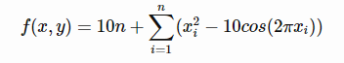
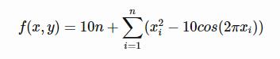
 |  | PSO | ALO | ALO' | GA
Griewank Function(30) | average | 49.54458 | 124.6942 | 15.897926 | 12.87397
 | best | 39.23749 | 4.797168 | 10.032652 | 9.539955
 |  | PSO | ALO | ALO' | GA
Rastrigin Function(30) | average | 380.8994 | 352.9864 | 428.71056 | 150.3536
 | best | 348.3837 | 288.0911 | 287.49639 | 127.6632

Slide 12
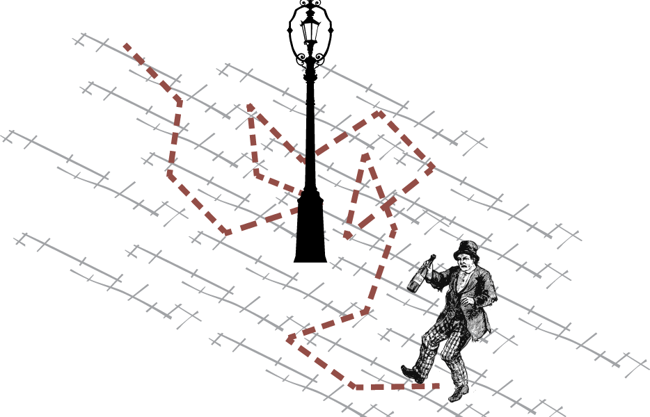
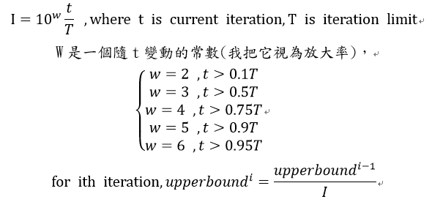
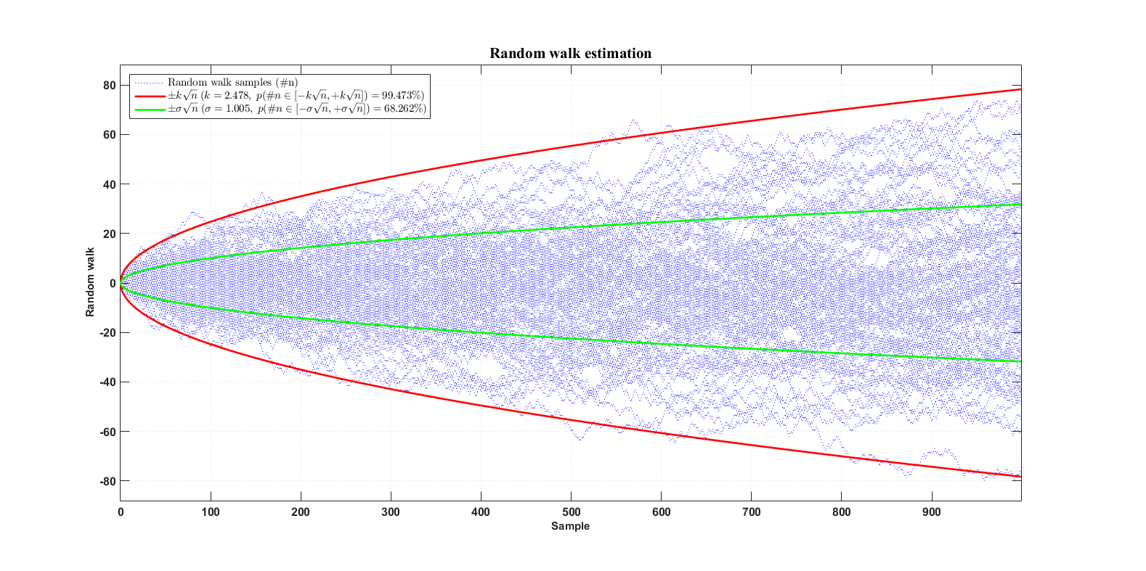
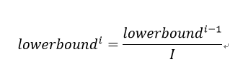

Slide 13
The End

